Slide 1

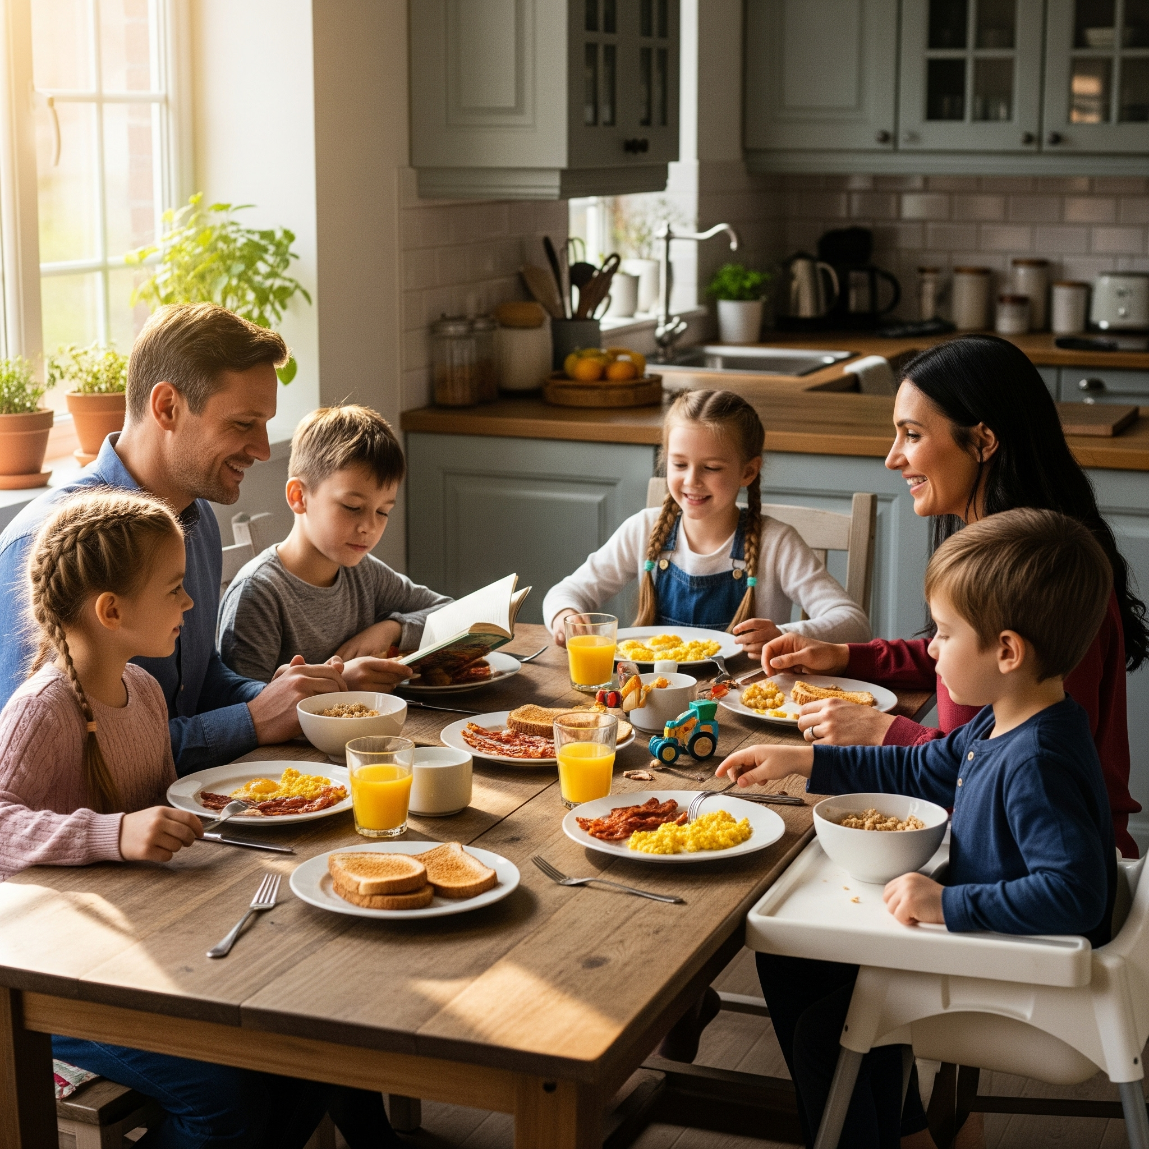

Reinventing Grocery through Personalized Agentic Commerce
Built for Retailers. Loved by Shoppers.

Slide 2
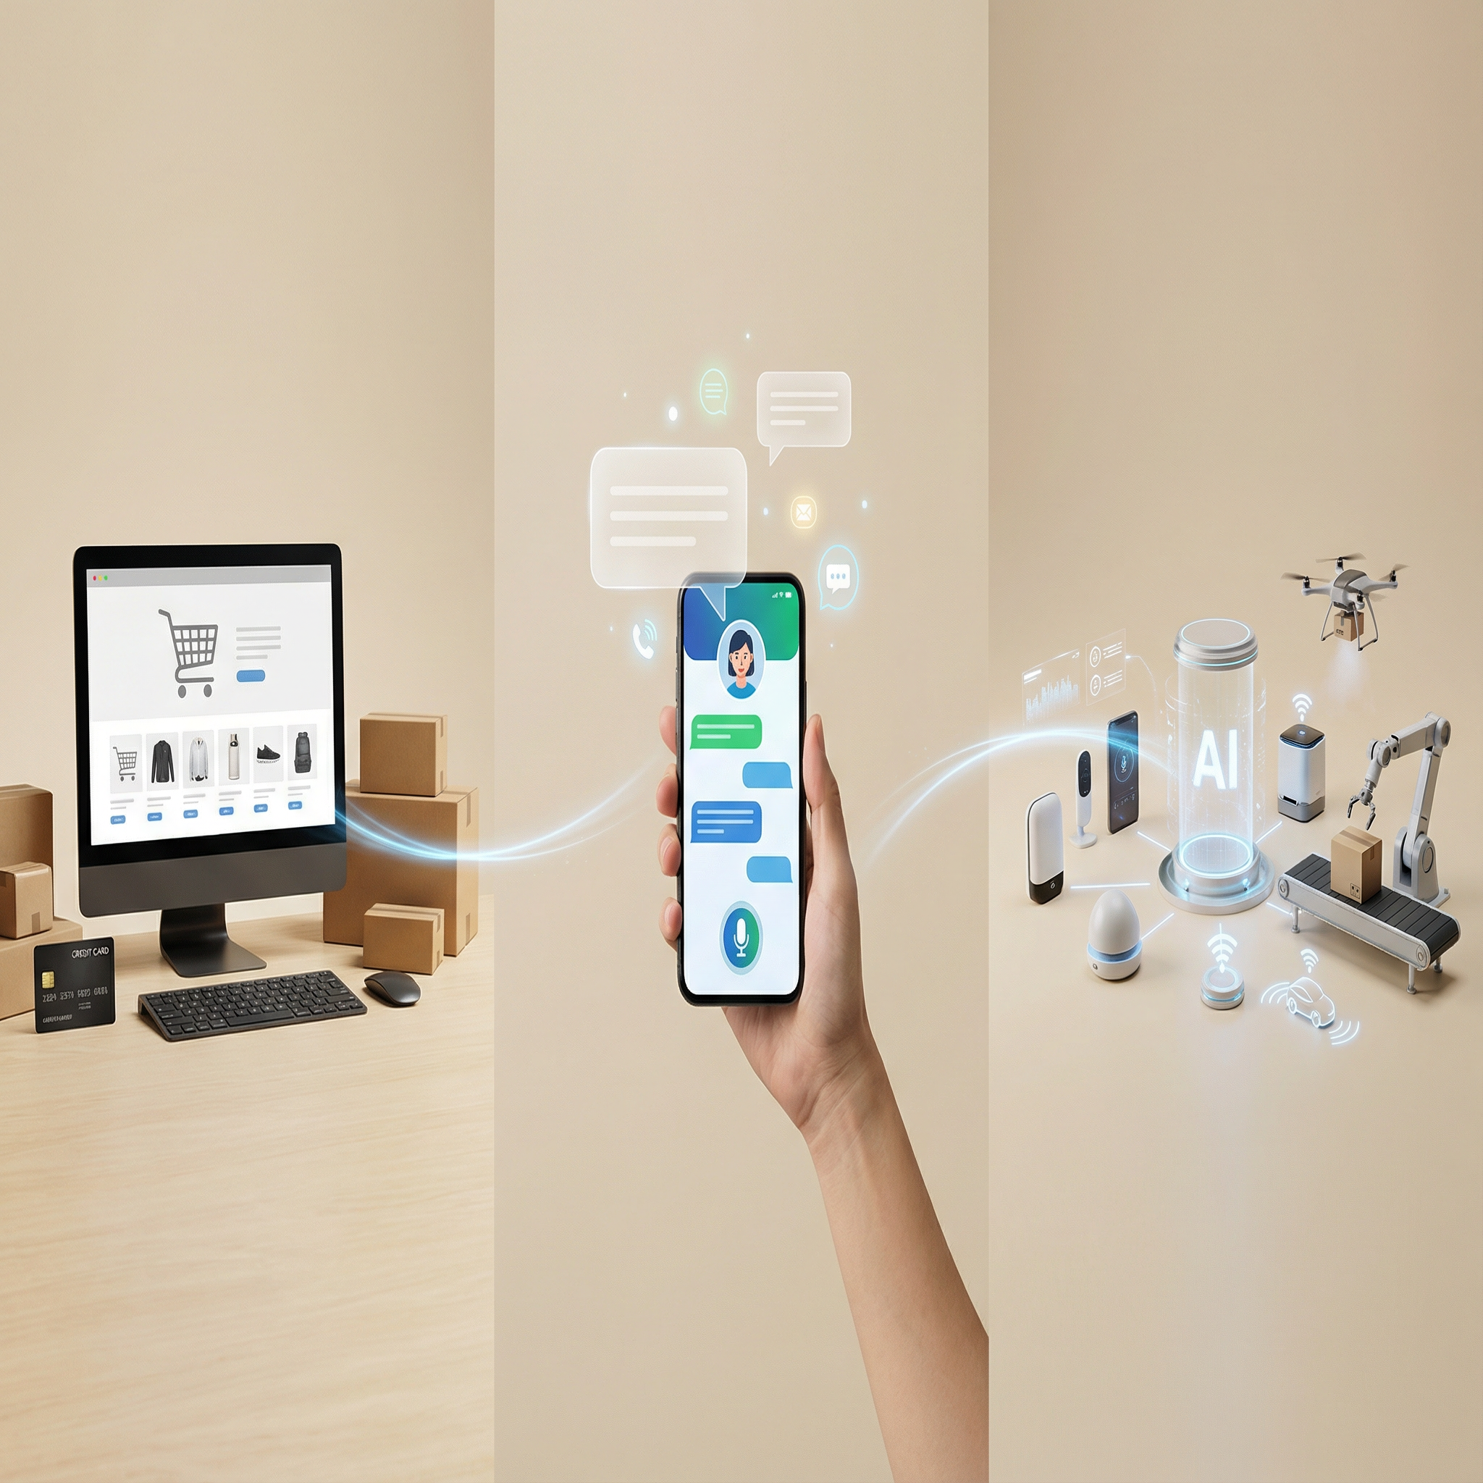
Every Industry is Evolving.
TRADITIONAL
CONVERSATIONAL
AUTONOMOUS

Slide 3
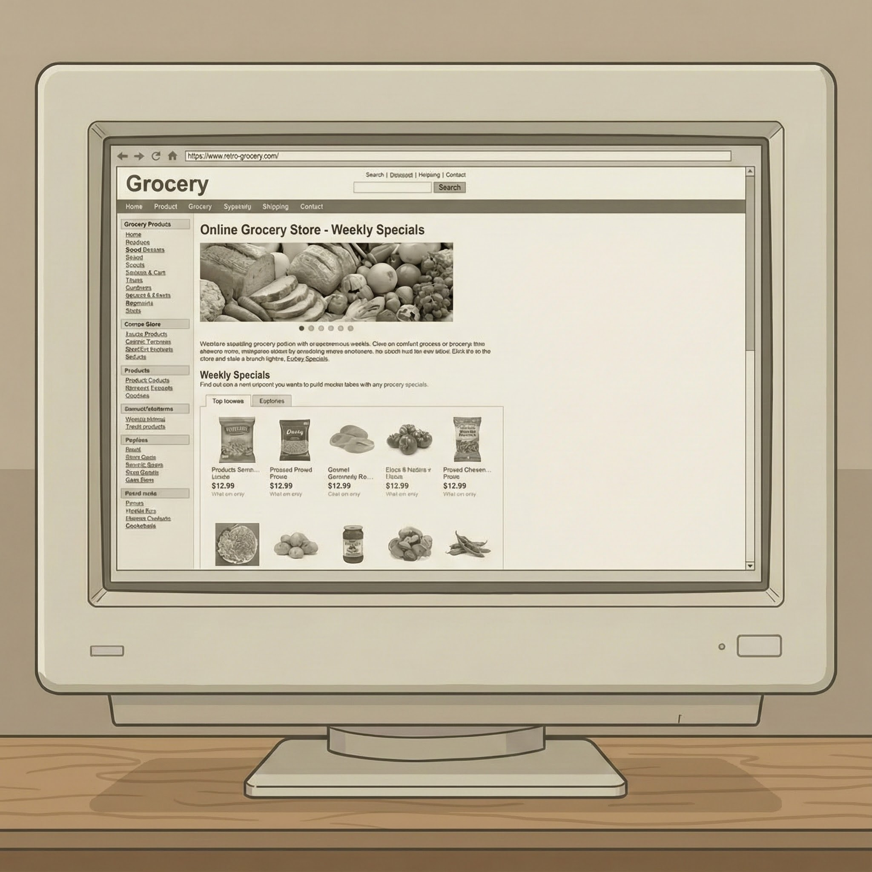
The Problem: Online Grocery Is Fundamentally Broken
Clunky Digital Experiences
Regional grocers stuck with outdated, unintuitive platforms
One-Size-Fits-All Commerce
Generic carts, irrelevant coupons, meaningless recommendations
Zero Food Intelligence
No understanding of nutrition, health, culture, or household context
Revenue Left on Table
Low loyalty, poor conversion, missed monetization opportunities

Slide 4
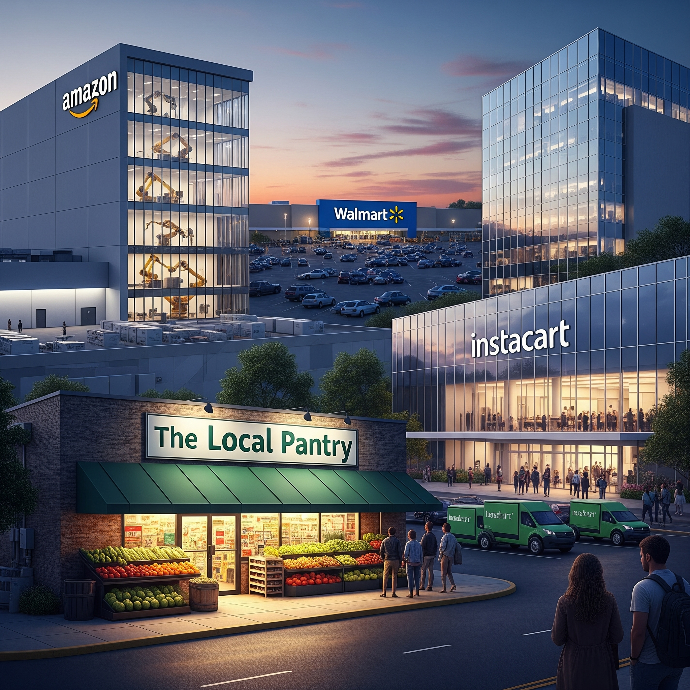

The Real Threat: Big Tech Giants Own the Customer
Amazon, Walmart, Instacart, Meta Dominate Discovery
Platform giants control shopper relationships, data, and loyalty
Retailers Lose Control, Lose the Data
Customer journey, monetization, and data ownership slip away
Agencies & Ad Networks Siphon CPG Dollars
Retail media intermediaries extract margin without adding value
Without action, regional grocers become distribution nodes and not destination brands.

Slide 5
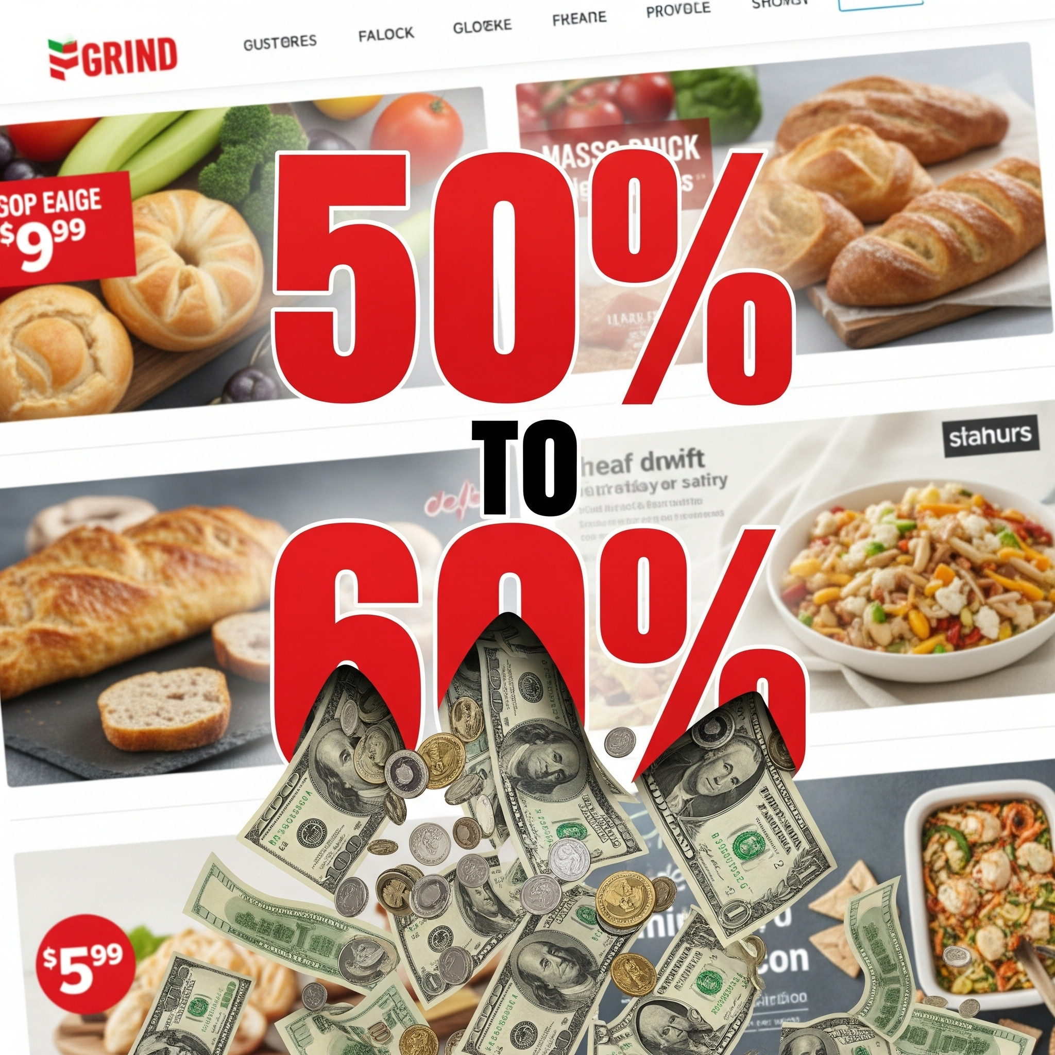
Retail Media’s Hidden Tax: Unfair Share of Advertising Revenue
Middleman Tax
Agencies and retail media networks sit between retailers and CPGs, siphoning a disproportionate share of ad revenue
Uncaptured Value
Grocers provide the shoppers, data, and digital real estate — but don’t capture their fair share of value
Placement Blindness
CPGs lack true control over placement and timing, limiting relevance and ROAS
Lack of Hyper Targeting
One-size-fits-all targeting ignores real shopper intent, context, and household behavior
Loss of First Party & Ad Performance Data
Retailers lose shopper behavior data and visibility into ad performance
OPPORTUNITY: Retailer-owned ads with AI-driven targeting delivers revenue for grocers and better performance for CPG

Slide 6
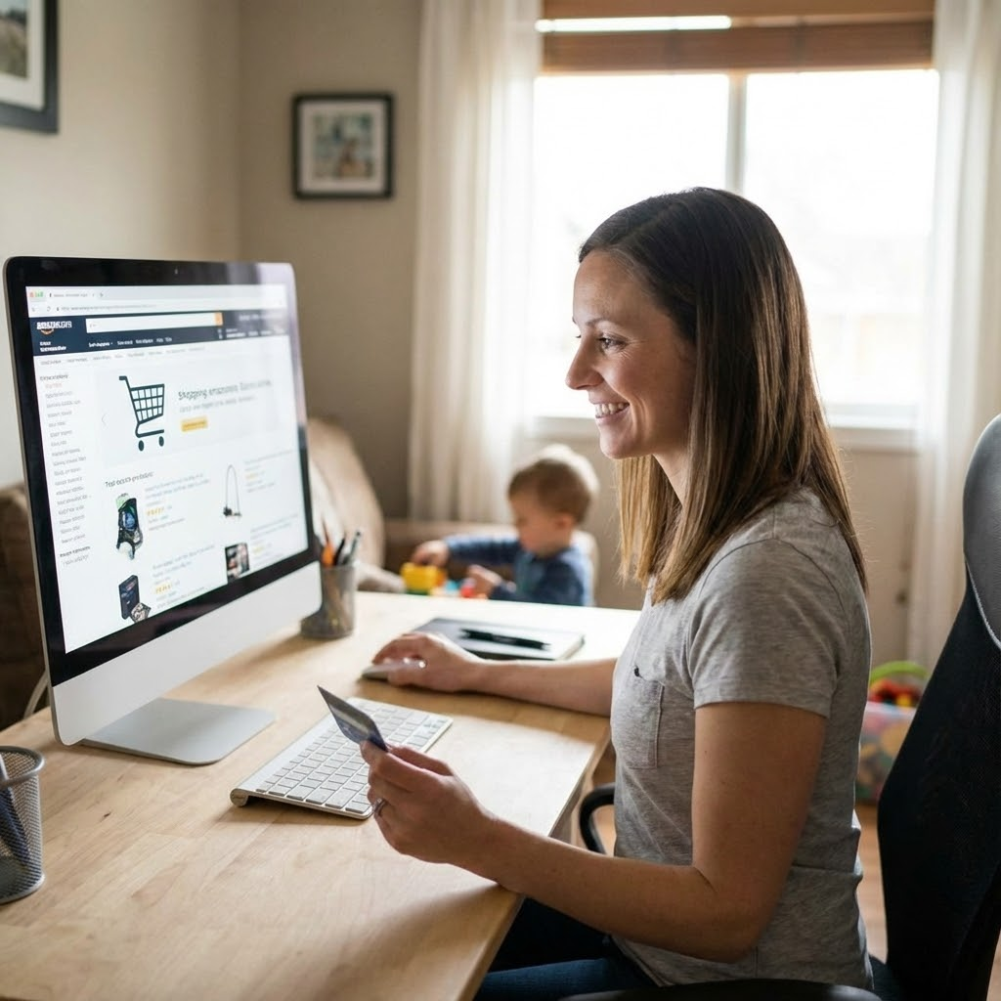
AI-Driven Commerce Is Already Reshaping Retail Economics
Proven Sales Uplift
Personalized commerce drives 10–30% sales uplift across leading retailers.
Recommendation Power
AI recommendations generate ~35% of Amazon’s revenue and lift AOV and conversion.
Autonomous Commerce
Agentic AI saves shoppers time by finding products and building optimized carts.
Step-Change Growth
AI-powered experiences deliver 15–25% higher conversion and 10–30% larger baskets.
High Margin Media
AI-driven, direct-to-CPG hyper targeting unlocks higher-margin ad revenue.

Slide 7
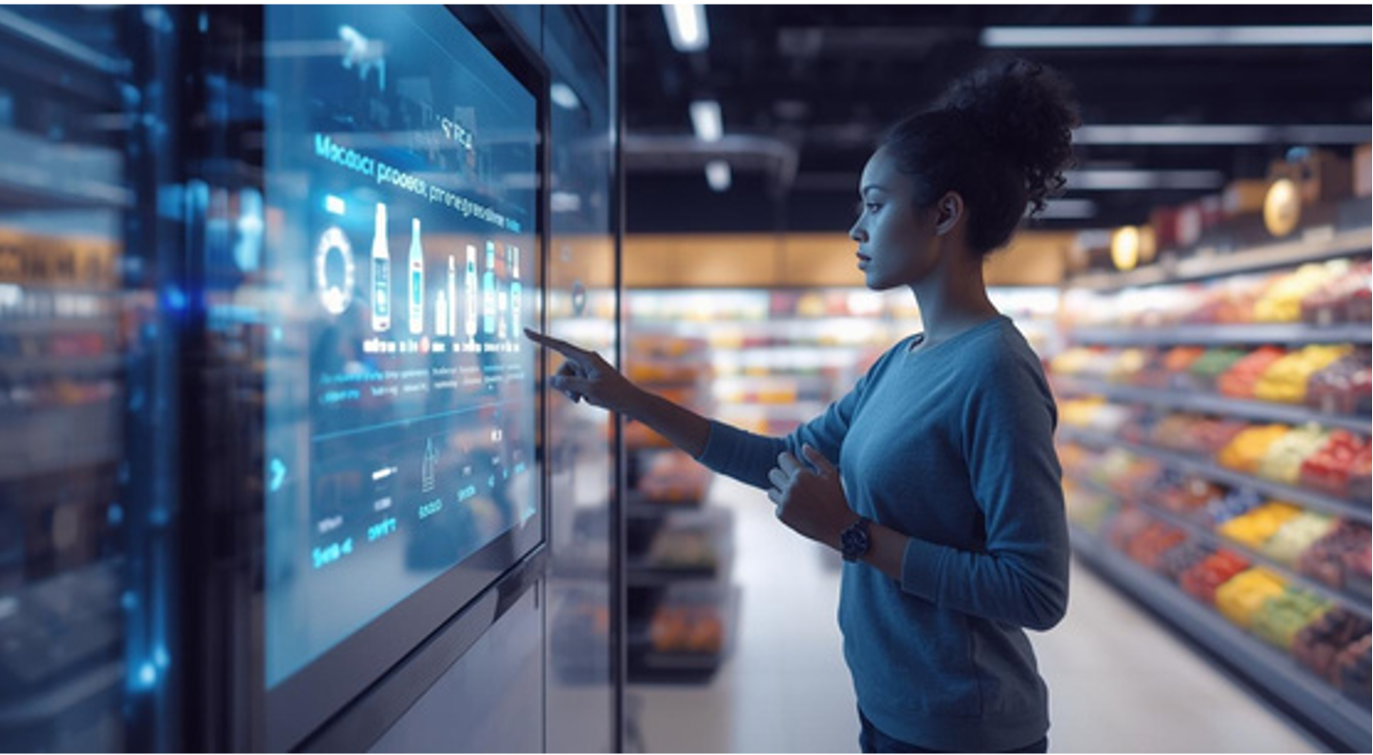
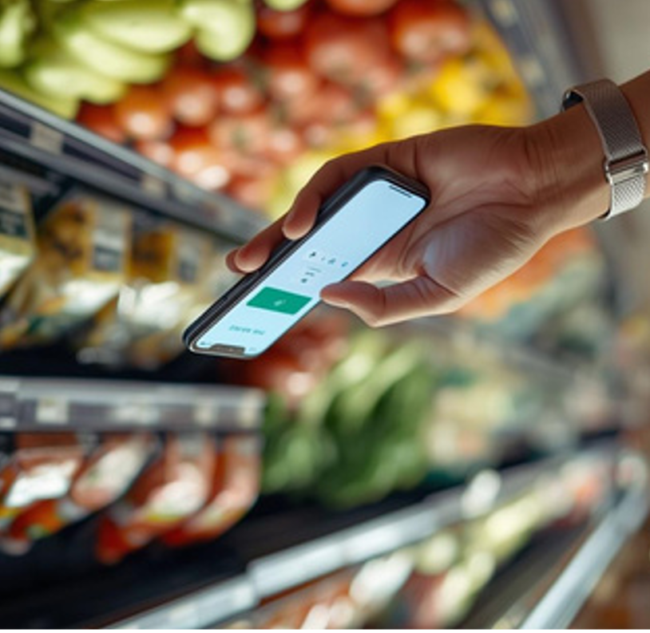
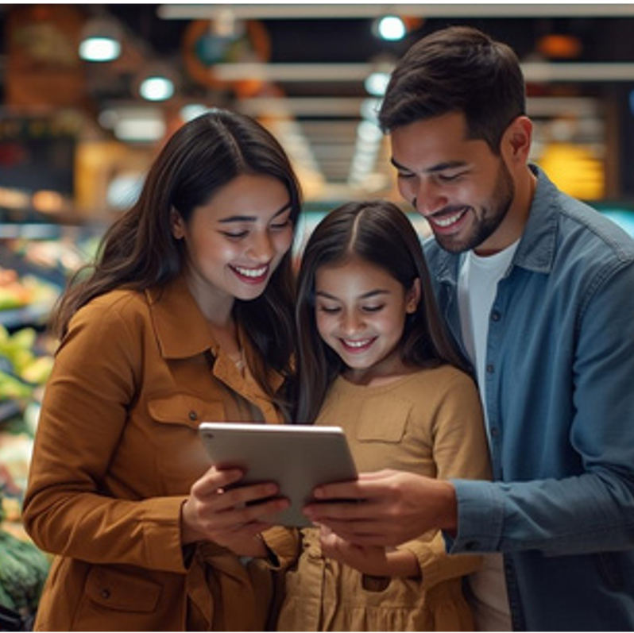
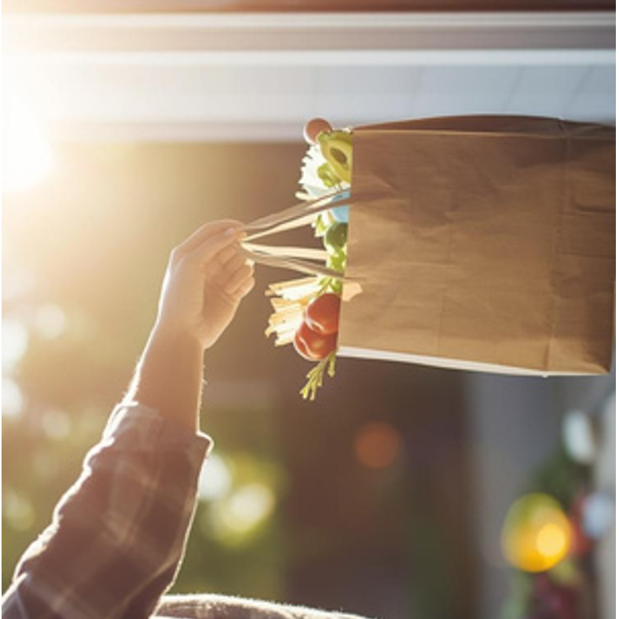
Our Breakthrough:
Personalized Agentic Commerce
AI Agents Act for Shoppers
Unified Experience
Systems plan, decide, and execute — not just recommend
Commerce, advertising, and social discovery in one intelligent journey
Food/Shopper Intelligence
Hyper Personalization
Built for Grocery
Every interaction tailored to household needs and preferences
Purpose-designed for food, not generic eCommerce
A new category where food and shopper intelligence becomes core infrastructure positioning Delectable AI as the AI company for Grocery Commerce.

Slide 8
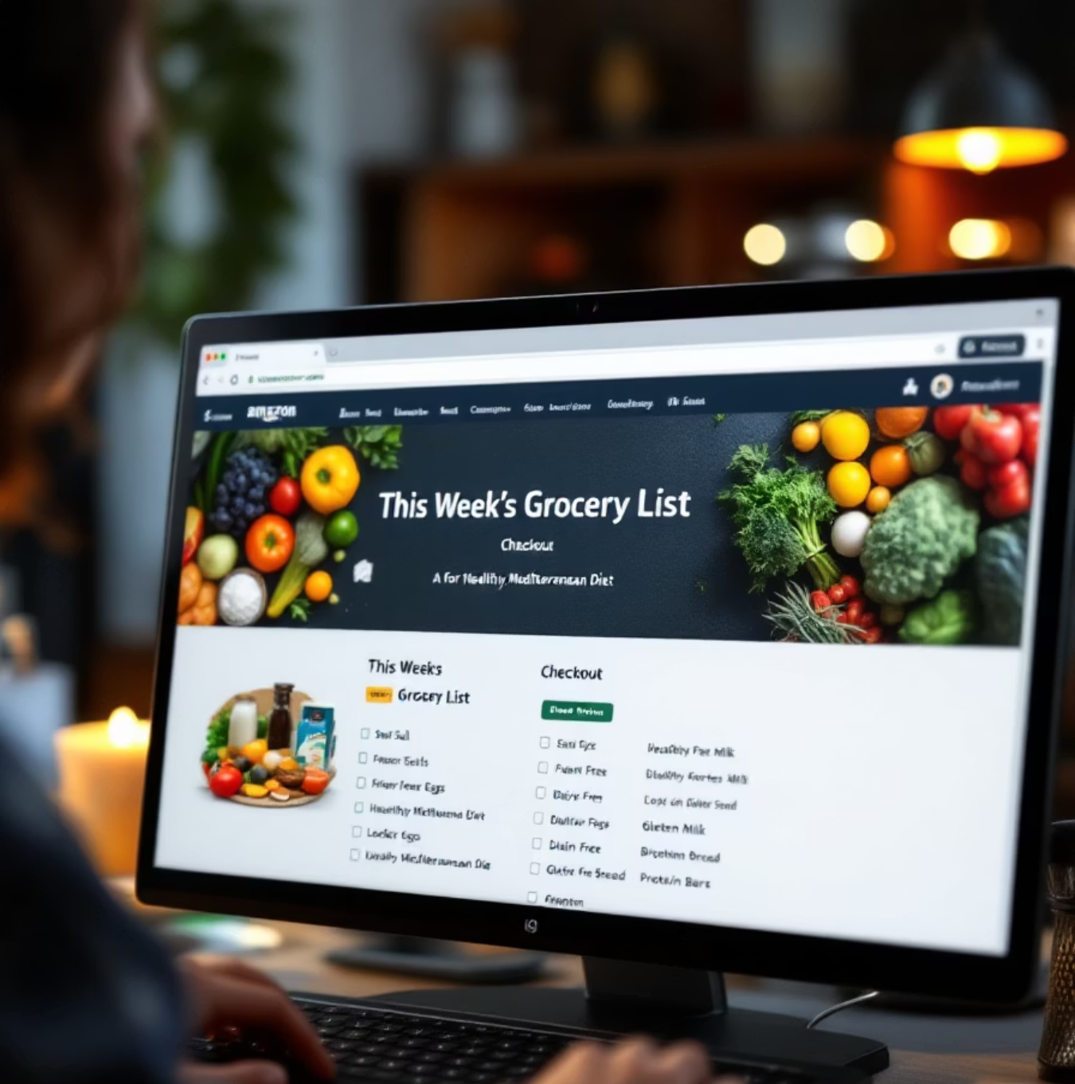
What We Deliver: The Perfect Cart
Learns Your Household
Tastes, dietary restrictions, health goals, cultural preferences, budget constraints
Pantry & Meal Aware
Knows what you have, what you need, what you love to cook
Dynamically Curated
Every cart tailored to your family's unique context
Continuously Adapts
Real-time learning as preferences and behaviors evolve
Shopping just got effortless. Delectable AI learns your customers’ preferences, shops on their behalf, and builds the perfect cart every time.

Slide 9
The Platform:
Delectable Agentic Experience Platform™ (AXP)
Unified AI Platform
Zero Replatforming
Intelligent Orchestration
Enterprise-Grade
Powers all shopper experiences and monetization streams
Sits on top of existing eCommerce stacks — integrate, don't replace
Manages data, decisions, automation, and revenue generation
Built for scale, security, extensibility, and rapid deployment
The operating system for AI-powered grocery commerce

Slide 10
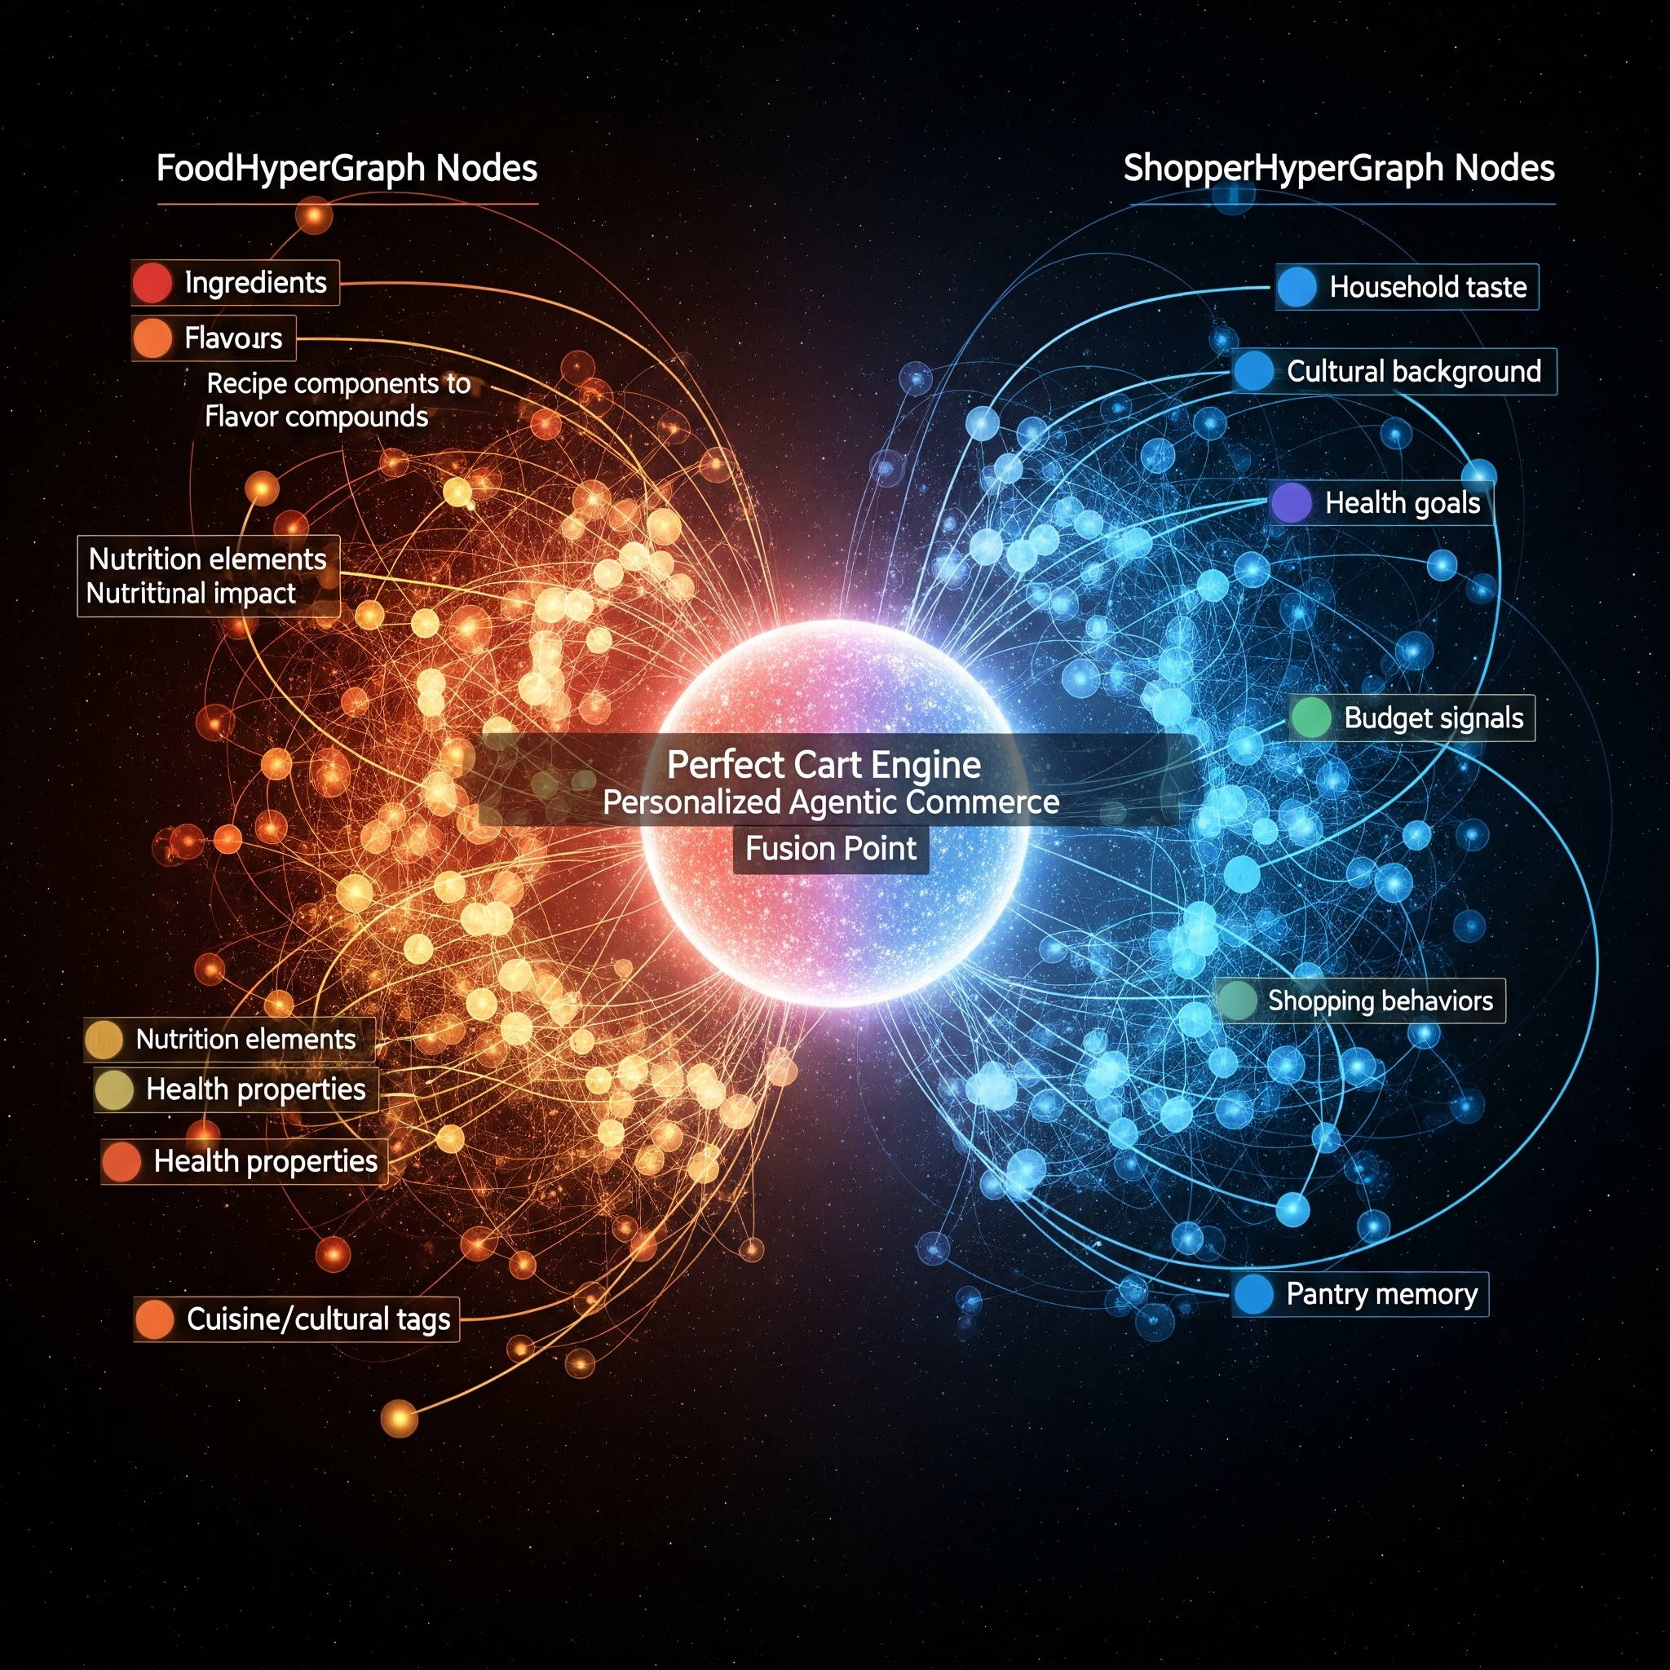

Our Moat
Food & Shopper Intelligence No One Else Has
Food HyperGraph™
Computational gastronomy at molecular depth
Ingredient × flavor × nutrition × health modeling
Allergens, dietary science, culinary patterns
Shopper HyperGraph™
Household-level preferences and behaviors
Real-time intent signals and context
Budget optimization and purchase memory
Proprietary knowledge no generic AI can match
True 1:1 hyper-personalization engine
Together, these knowledge engines create defensible, category-defining AI

Slide 11



Three Applications. One Intelligence Core.
Delectable Commerce
Delectable Social
Delectable Ads
Agentic shopping, meal planning, Perfect Cart creation
Shoppable short-form video, creators, social discovery feeds
Retailer-owned CPG advertising with measurable ROAS
Delectable Agentic Experience Platform
Food HyperGraph
Shopper HyperGraph
Hyper-Personalization Engine
Agent Orchestration
Ingredient, flavor, allergies, nutrition, diet, recipe and health modeling.
Household-level preferences, behaviors, and real-time intent signals.
True 1:1 commerce tailored to each household's unique context.
Intelligent systems that plan, decide, and execute on behalf of shoppers.
All powered by AXP and unified food + shopper intelligence
Notes:
Platform approach
Cyclinder on the bottom.

Slide 12

Business Model: Platform-Driven, High-Margin Revenue
SaaS Platform Fees
Recurring enterprise licensing for AXP access
Take-Rate on Commerce
Revenue share on basket uplift and transaction value
Take-Rate on CPG Ad Revenue
Direct CPG ad sales through retailer-owned network
Take-Rate on Social Ad Revenue
Revenue share of Social Ad sales from Retailer RMN to CPG
Recurring, scalable, margin-rich platform economics

Slide 13

Traction, Early Proof, Tailwinds
First Enterprise Contract Closed
Strong Sales Pipeline
Major grocery retail 7-figure agreement signed with Giant Eagle.
Strong inbound interest from over a dozen enterprise grocery retailers.
Grocery Retailers’ Board Pressure
Market Validation
Urgency to leverage AI in all aspects of the business, but especially driving revenue.
Product-market fit confirmed through 12 months of executive conversations.
Early wins and traction prove the category exists and that we can win it.
Notes:
Market Validation. Product Market Fit verified with dozens of conversations with Grocery Executives past 12 months

Slide 14
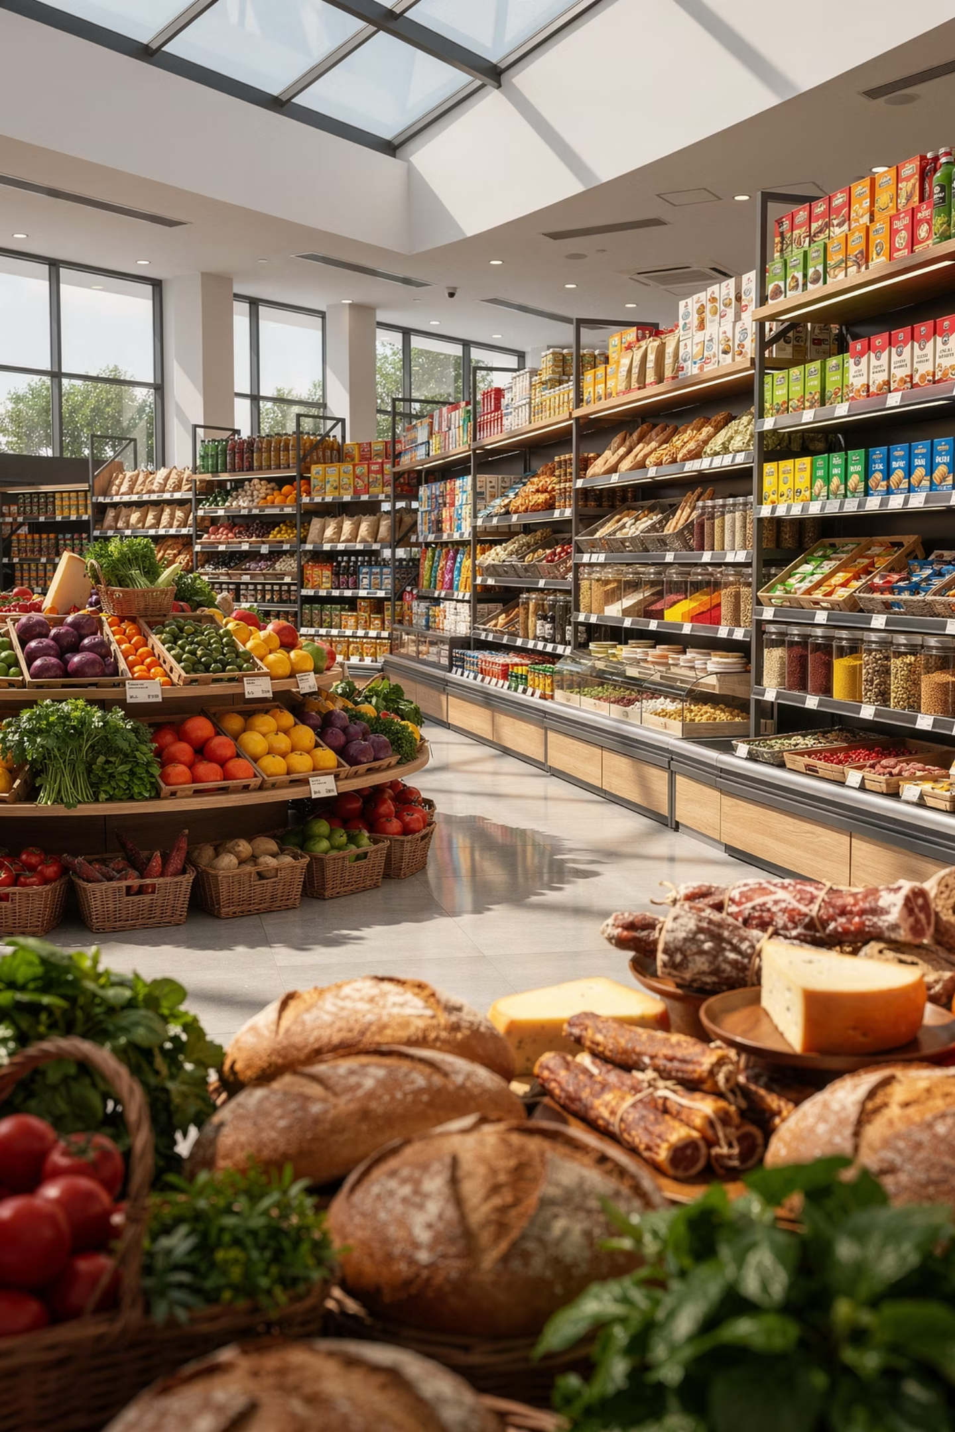
Market Opportunity: Reinventing a Trillion-Dollar Industry
$12T
$100B+
$1.4T+
Global Grocery Market
Retail Media Alone
TAM
Multi-trillion-dollar category ripe for AI transformation
Rapidly growing advertising category grocers are claiming
We unlock new revenue across commerce, media, and social
Positioned to become the system of record for grocery AI, capturing value across the entire shopper and advertiser journeys
Notes:
Steal numbers from Julianna, Vikal

Slide 15



Treasures from AI, Grocery & Retail Experience and Network
Joseph Lee - CEO and CRO
+ 26 years experience in sales and marketing, e-commerce expert, C-Suite and Board member.
Led VTEX from $400M to $4.7B, as the Chief Revenue Officer, resulting in a NYSE IPO.
Drove market penetration at ATG - acquired by Oracle for $1B.
Grew hybris from $6M to $115M in revenue resulting in a sale to SAP for $1.5B.
As SVP Global Sales led the shift from services to product, growing MyWebGrocer (MWG) revenue from $68M to $120M - acquired by Mi9 Retail.
Sanjay Mehta - CPO
+ 25 years experience in enterprise technology and sales, ecommerce, search, and AI expert.
Google Vertex AI Engineering Principal at Kin & Carta / Valtech
Led Lucidworks AI & Search go-to-market leading to over 100% revenue growth in Commerce & Retail (B2C/B2B)
eCommerce Principal at ATG, Endeca, NetSuite – all acquired by Oracle
Solution Architecture leader at Reflektion, and at AI hyperpersonalization (acquired by SiteCore)
Proven impact across Fortune 1000 brands
Patrick Hoeffel - CTO
+ 30 years experience in software engineering
Leader & Technologist with hands on expertise in AI, Cloud, Enterprise Search, Data Intelligence, eCommerce, Knowledge Graph. VP of Professional Services, Partners & Alliances, Enablement.
Industry expertise includes eCommerce, Financial Services, Insurance, Defense, and Global Markets
Passionate about transforming raw data into actionable intelligence.
Experience in multiple startups from early dev through exit.

Slide 16




Backed by Advisors with Trusted Market Expertise
Art Sebastian is the Founder & CEO of NexChapter Inc., advising convenience retailers and tech firms on innovation and growth. Former VP of Digital at Casey’s, where he launched their loyalty program, e-commerce, and retail media network. He’s held leadership roles at Meijer and Kraft Foods, currently serves on the Shoptalk and C-StoreTEC advisory boards.
Amit Shah is a B2B SaaS leader that has a strong VC and PE background.
Former Chief Revenue Officer at SAP, Chief Strategy Officer at VTEX, and Board Member of Magnolia CMS. Amit has deep expertise in growing and scaling companies as a former founder and entrepreneur. Amit holds a degree from the University of Chicago and is known for thought leadership and technology transformation.
Dilip Keshu is an award-winning CEO with a distinguished career in digital transformation and content production. As the leader of BORN Group, he has collaborated with renowned brands such as Sotheby's, Nike, Starbucks, and Unilever. Under his guidance, BORN has become a globally recognized agency, earning over 50 awards across more than seven countries. In 2019, BORN Group was acquired by Tech Mahindra, marking a significant milestone in its growth.
Vikal Kapoor is the Founder & Managing Partner of SevenTrainVentures, with deep experience in fintech, venture capital, and digital transformation. Former CEO of Stateset Inc. and Dapps Inc., leading enterprise blockchain innovation. Earlier held roles at Bloomberg, Bank of America, Deutsche Bank, and JPMorgan across strategy and operations.

Slide 17
The Ask: $3M SEED
Product Development
1
Accelerate AXP capabilities, agentic systems, and hypergraph intelligence
Scale Sales & Marketing
2
Land anchor retailer partnerships and build go-to-market engine
Unlock Revenue Traction
3
Prove category economics and position for Series A readiness
"This round unlocks the category-defining platform that changes how billions of people shop for food"
Join us in building the AI company for grocery commerce.

Slide 18
EXTRAS

Slide 19
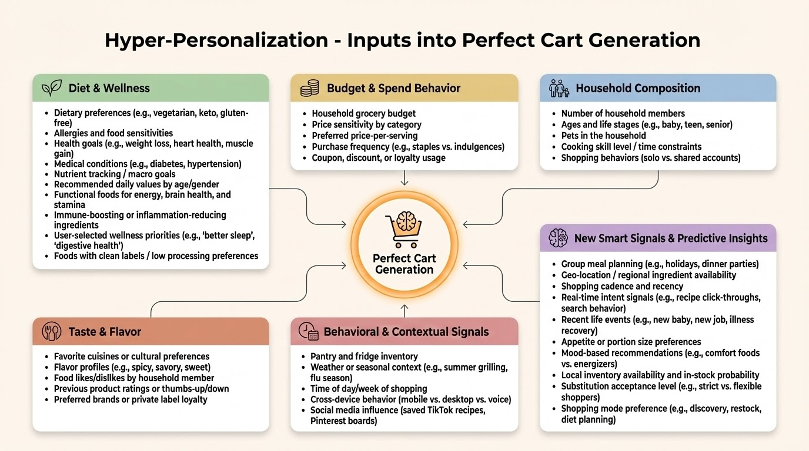

Slide 20
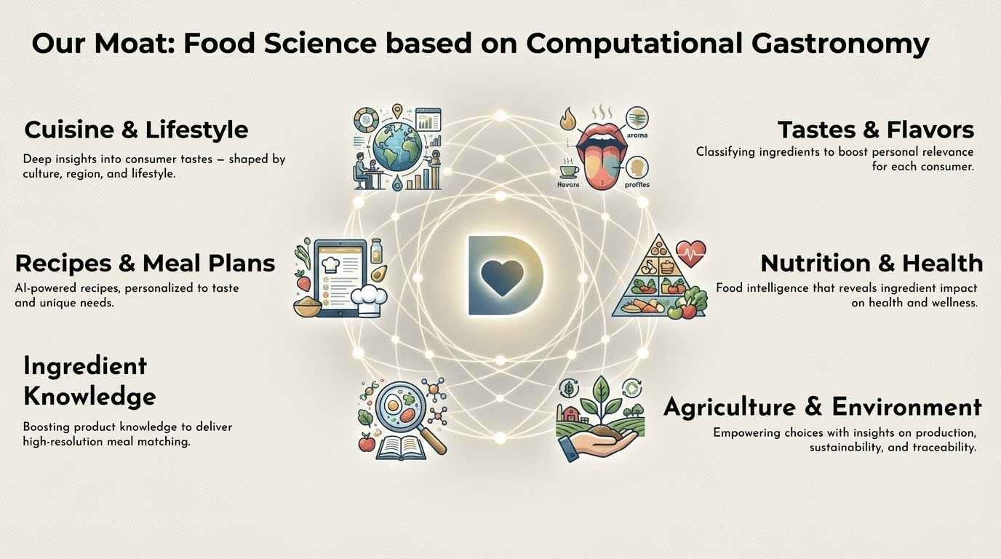

Slide 21
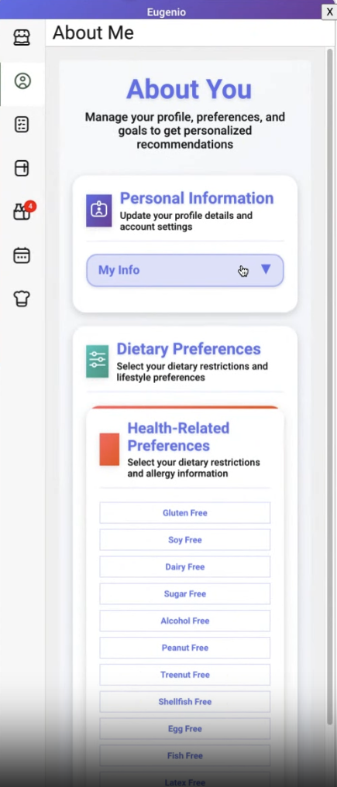
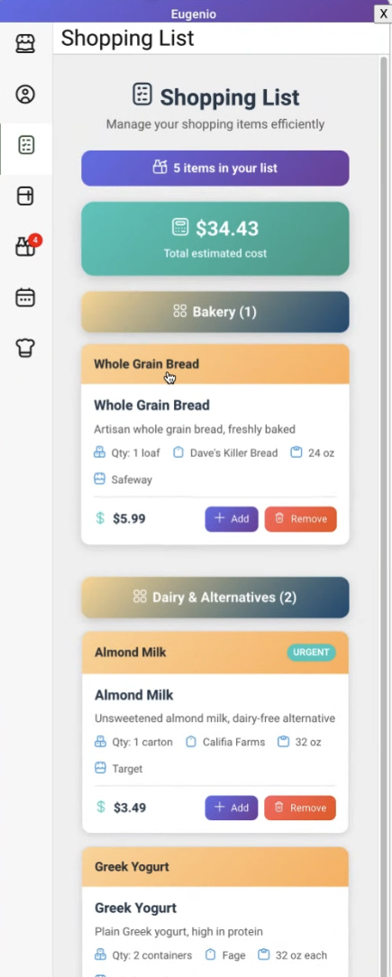
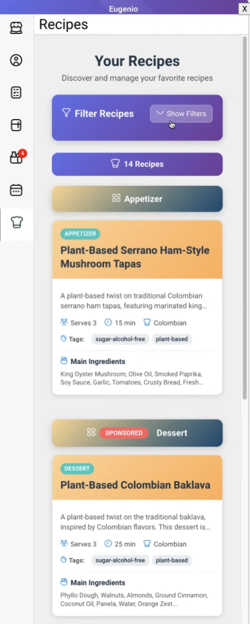
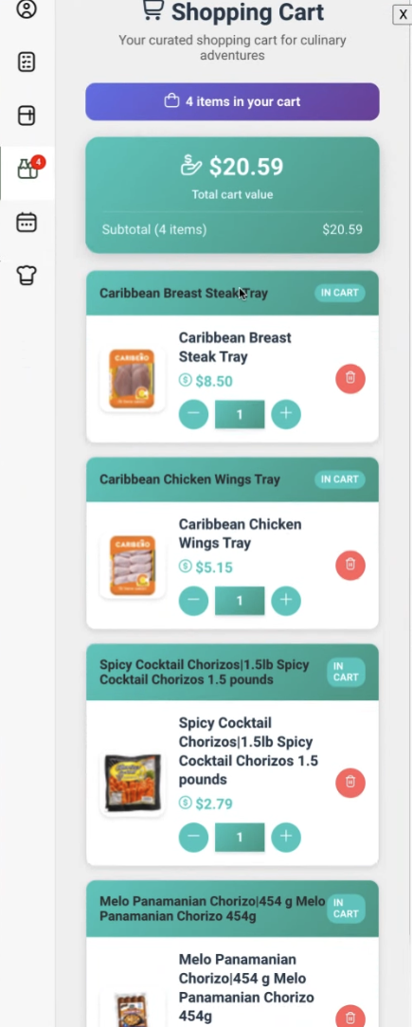
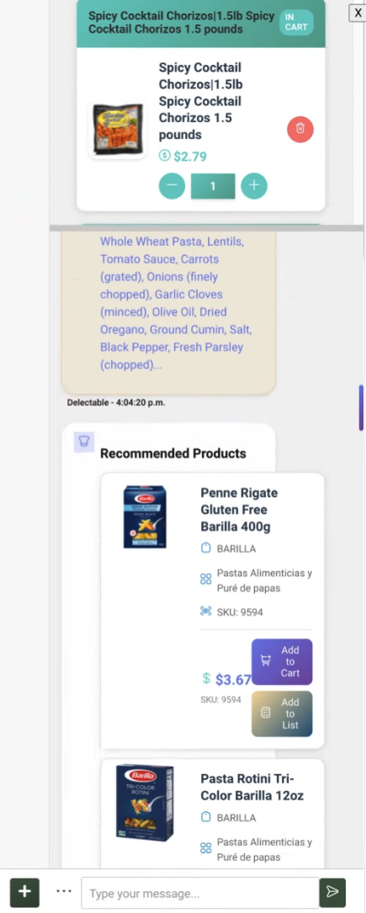
Sample Screenshots - Delectable Commerce™

Slide 22
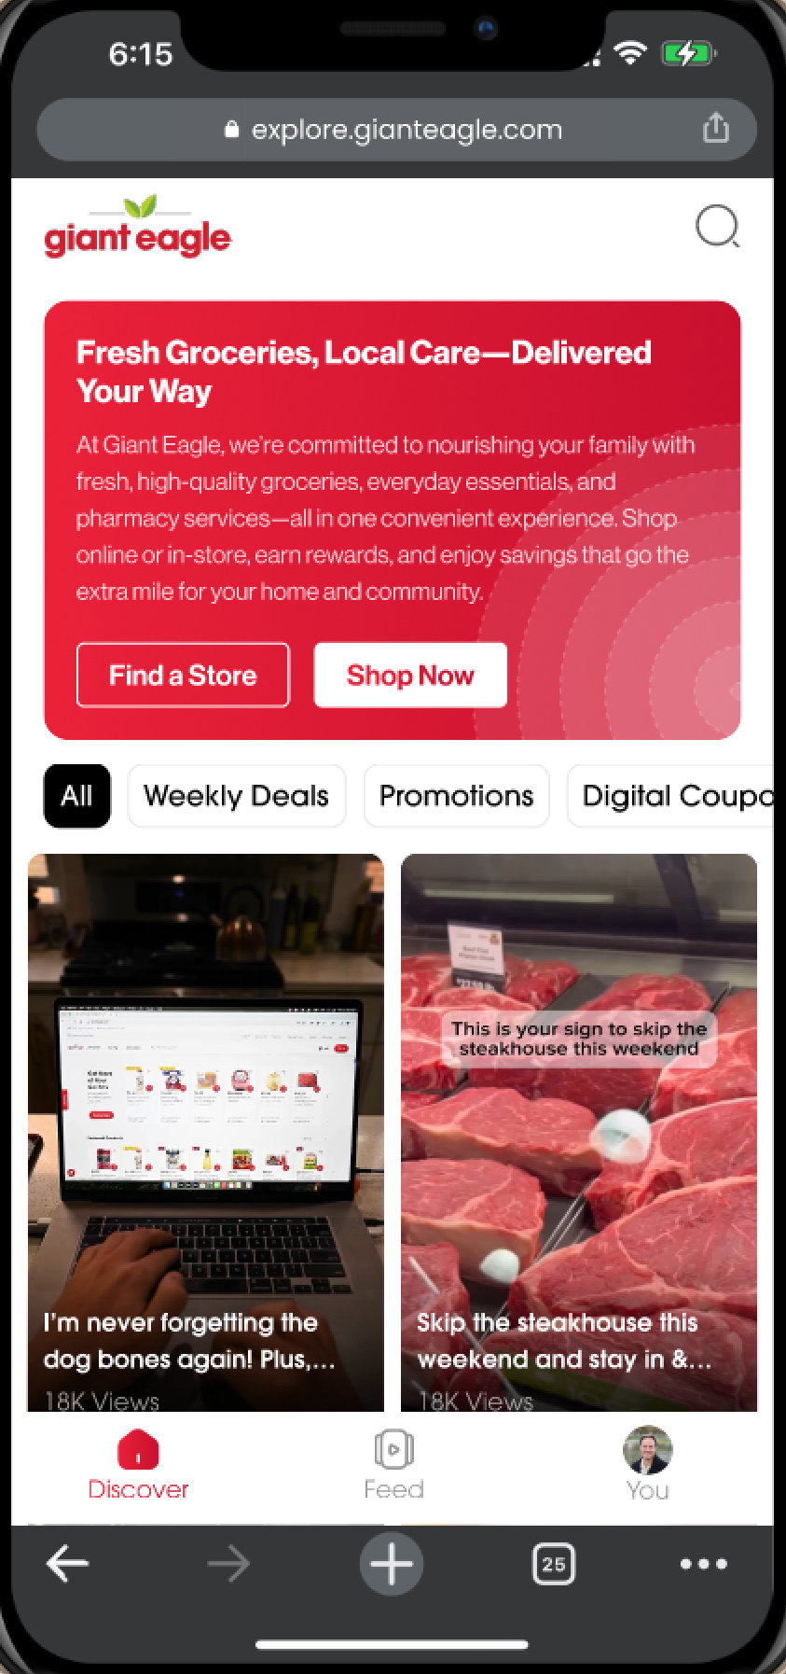
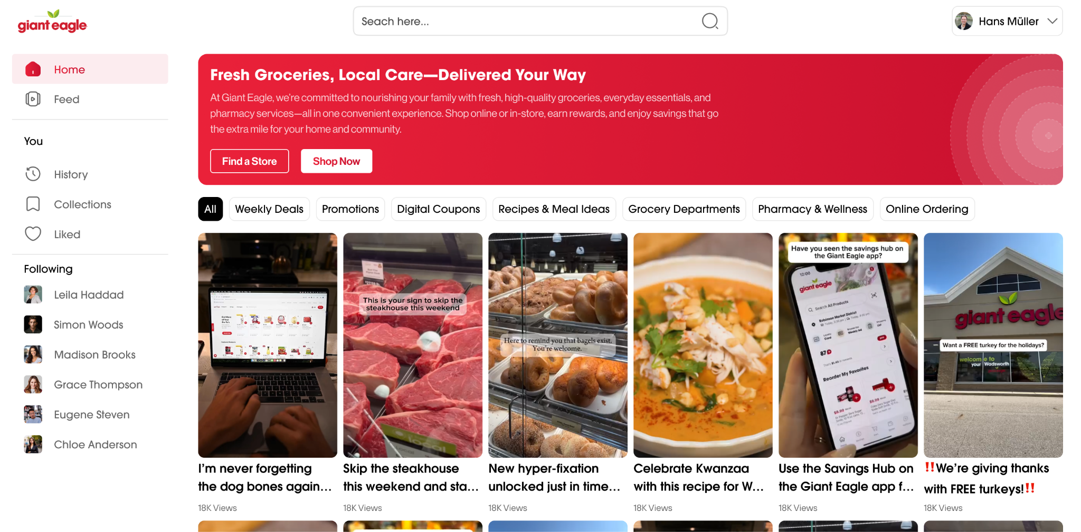
Sample Screenshots: Delectable Social™
Video-first agentic GenZ social commerce platform
“90% of the offerings, stories and social proof GenZ and Millennials consume in a day are in the form of vertical short videos”
Notes:
Yvon

Slide 23
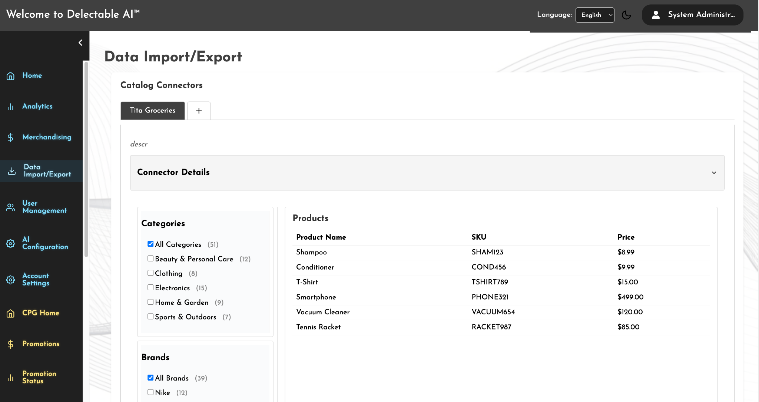
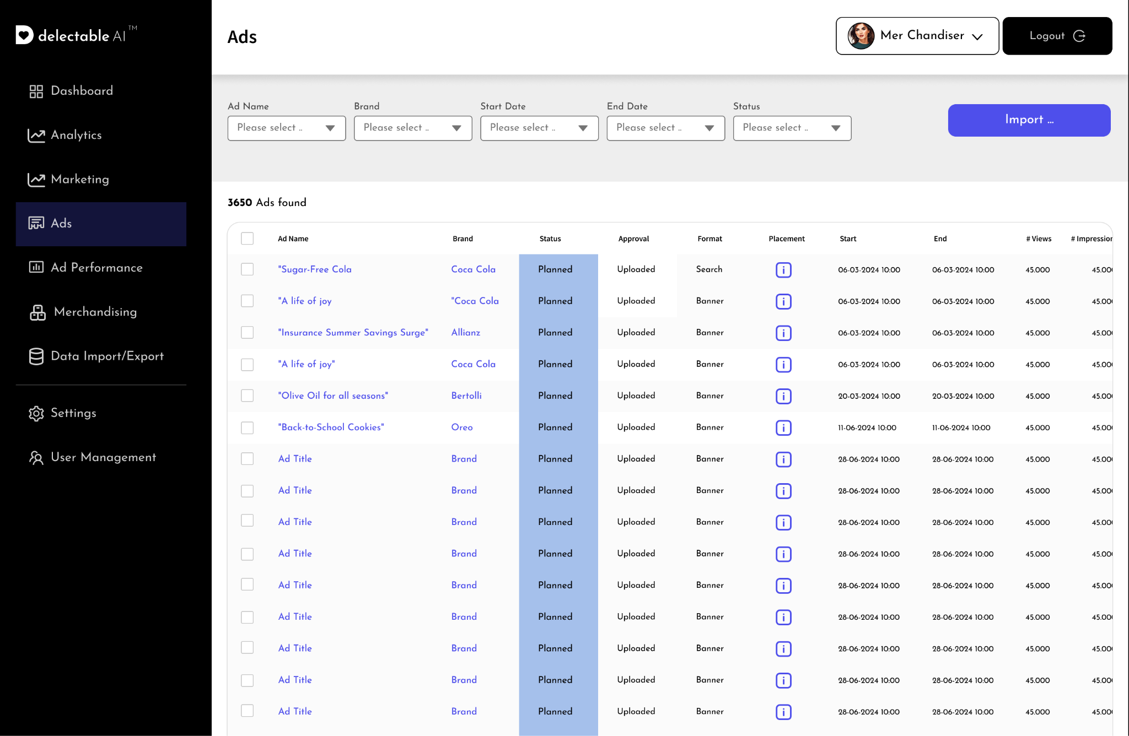
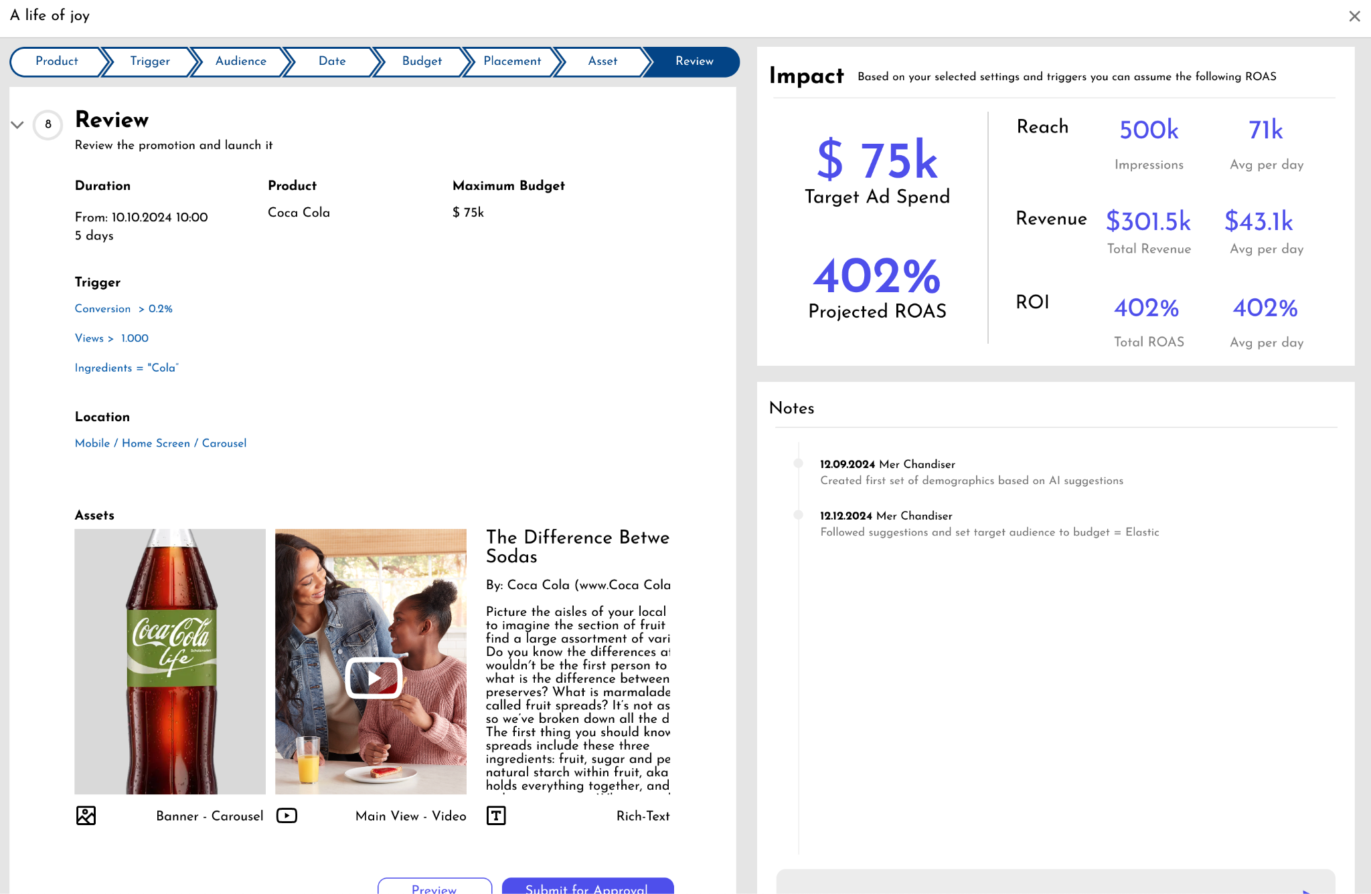
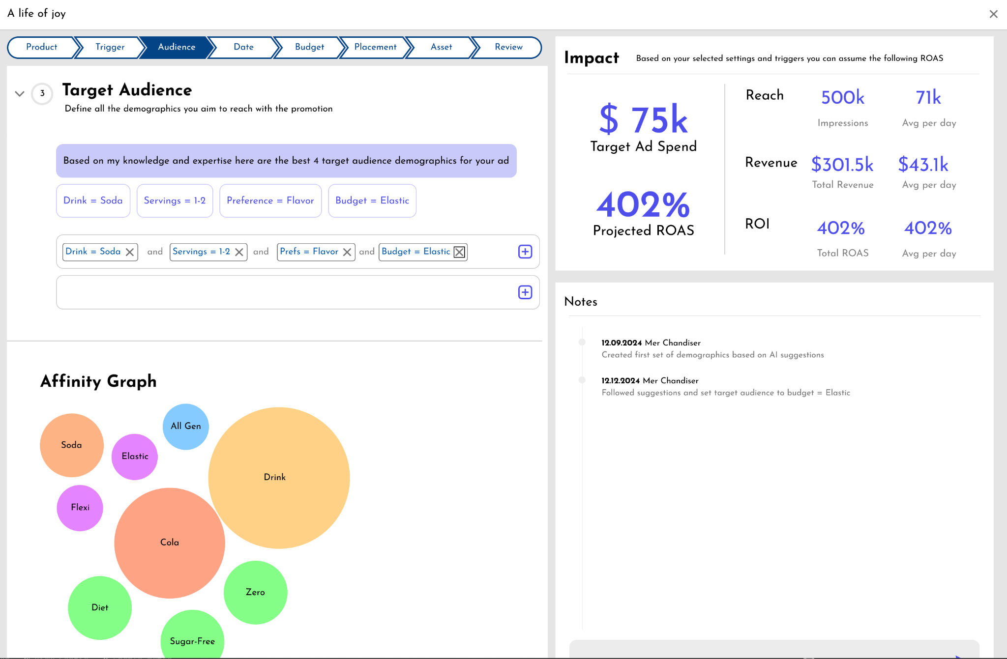
Sample Screenshots - Delectable Ads™

Slide 24

Grocery Industry Overdue for AI and Digital Transformation
AI Has Transformed Everything but Grocery
Media, finance, travel — reimagined by intelligent systems
Grocery Remains Stuck
Clunky interfaces, generic experiences, outdated technology
Shopper Expectations Reset
Amazon, Instacart, Walmart raising the bar daily
The Moment Is Now
Generative and agentic AI enable true 1:1 grocery commerce
Retailers must modernize now or risk losing relevance in the AI era
Notes:
SALES DECK: Talk about digital transformation being more then AI, Need Executive level sponsorship, clean data, right AI moral strategy, interdisciplinary project, moment is now.
Change Management.
Our expertise
Challenge: Fragmentation of AI across tactical projects. Proliferation of AI tools.

